Slide 1
KMP Algorithm for Pattern Searching
Prepared by
Lec Shekh. Md. Saifur Rahman
PREPARED BY
SWAPNIL BISWAS

Slide 2
Problem Statement
Given a text txt[0 . . . N-1] and a pattern pat[0 . . . M-1], write a function search(char pat[], char txt[]) that prints all occurrences of pat[] in txt[]. You may assume that N > M.
Example:
Input: txt[] = “THIS IS A TEST TEXT”, pat[] = “TEST” Output: Pattern found at index 10

Slide 3
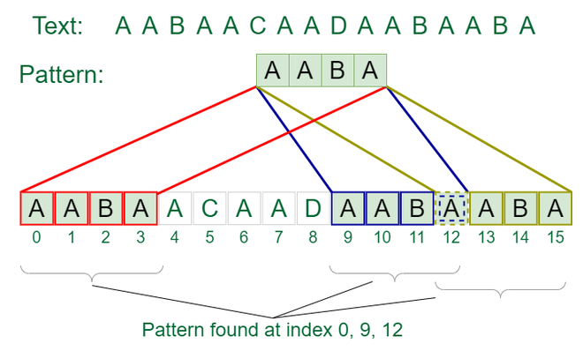
Example
Input: txt[] = “AABAACAADAABAABA” pat[] = “AABA” Output: Pattern found at index 0, Pattern found at index 9, Pattern found at index 12

Slide 4
Naive algorithm for Pattern Searching
Slide the pattern over text one by one and check for a match. If a match is found, then slide by 1 again to check for subsequent matches.
Example:
Input: txt[] = “AABAACAADAABAABA” pat[] = “AABA” Output: Pattern found at index 0, Pattern found at index 9, Pattern found at index 12
Time Complexity: O(N*M)
Auxiliary Space Complexity: O(1)

Slide 5
KMP (Knuth Morris Pratt)
Why KMP??
The worst case complexity of the Naive algorithm is O(N*M).
The time complexity of the KMP algorithm is O(N+M) in the worst case.
Application: finding keywords, searching for specific patterns, or filtering text
Reference:
https://www.geeksforgeeks.org/kmp-algorithm-for-pattern-searching/

Slide 6
Thank You
Questions

